Slide 1
Fuel Efficiency,
In-Cylindrical Pressure &
HRR Prediction

Slide 2
Algorithm With Explanation
The models considered in our analysis include:
1. Multiple Linear Regression:
a straightforward approach to modeling the relationship between multiple independent variables and a dependent variable.
a suitable choice for our multi-factor analysis of in-cylinder pressure.
2. Random Forest Regressor:
ability to handle complex relationships in data.
capable of capturing non-linear patterns and interactions between factors

Slide 3
Algorithm With Explanation
3. Decision Tree Regressor:
effective model for regression tasks.
decision tree regressors performed well in capturing the impact of various factors on in-cylinder pressure.
4. Gradient Boosting Regressor:
combines the predictions of multiple weak learners to create a strong predictive model.
known for their high accuracy in regression tasks.

Slide 4
Module Description:
Module 1: Data Preparation and Cleaning
1. Data Collection and Cleaning:
- Handling missing values.
- Standardizing the dataset.
- Removing outliers using the z-score test.
Module 2: Efficiency Calculation
1. Mass Calculation:
- Applying the provided formulas to calculate the mass of each fuel.
- Converting brake power to equivalent load.

Slide 5
. Efficiency Iteration:
- Implementing a Python loop for calculations.
- Setting and applying threshold.
3. Best Efficiency Identification:
- Tabulating the best efficiency fuel combination.
Module 3: Machine Learning for Pressure Prediction
1. Data Preparation for Pressure Prediction:
- Selecting relevant features.
- Utilizing the best efficiency fuel combination data.
2. Model Training and Validation:
- Splitting the dataset
- Evaluating and selecting the best-performing model.

Slide 6
3. Pressure Prediction:
- Using the selected model to predict pressure for 720 angles.
Module 4: Heat Release Rate (HRR) Analysis
1. HRR Calculation:
- Applying the provided formula for HRR.
- Incorporating pressure, volume, and relevant changes.
2. Visualization of HRR:
- Creating visualizations to represent the calculated Heat Release Rate.
Module 5: Model Performance and Results
1. Performance Metrics:
- Storing performance metrics for models.
- Documenting accuracy and error rates.

Slide 7
2. Results Storage:
- Compiling key results, predictions, and efficiency data.
Module 6: Conclusion and Recommendations
1. Summary of Findings:
- Summarizing the identified best efficiency fuel combination.
- Highlighting pressure predictions and HRR analysis.
2. Recommendations for Further Study:
- Suggestions for refining models or exploring additional factors.
Module 7: Documentation and Future Work
1. Methodology Documentation:
- Detailed documentation of the methods and assumptions used.
- Transparency in data processing and analysis.

Slide 8
Output:
Efficiency :

Slide 9
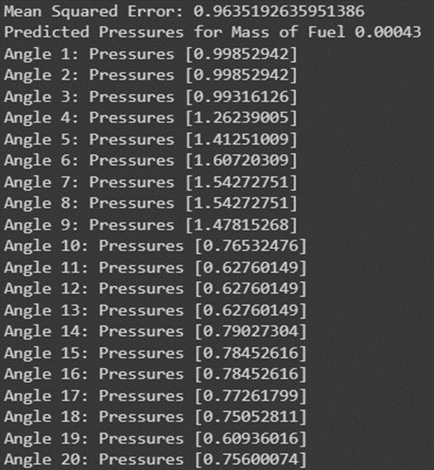
Pressure Prediction:

Slide 10
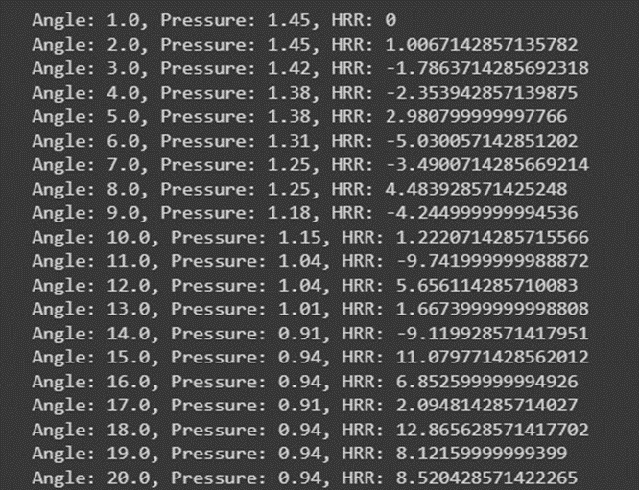
HRR:

Slide 11
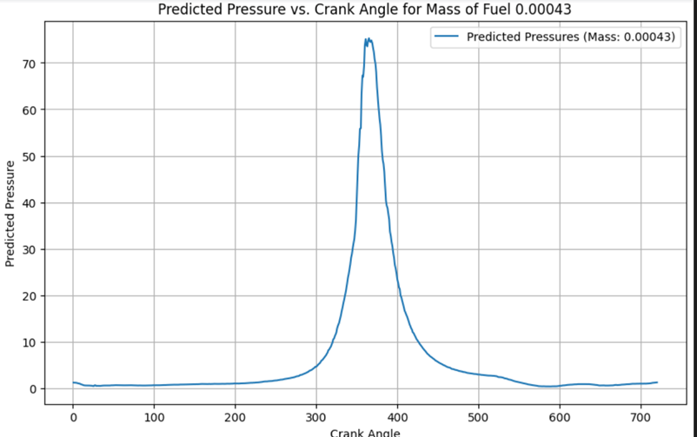
Visualisation:

Slide 12
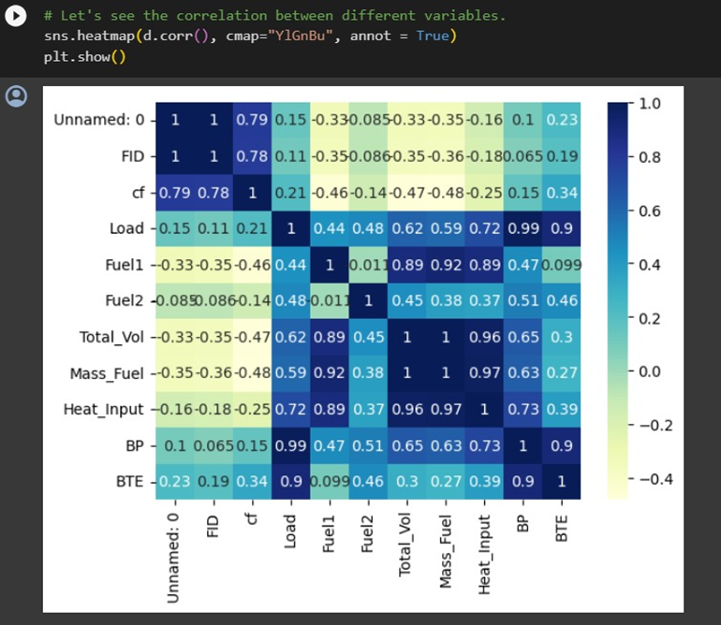
Performance Matrix:

Slide 13
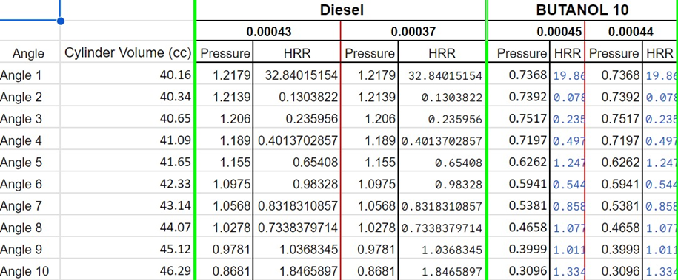
Final Pressure and HRR:

Slide 14
Draft Paper Status
Publication process not yet started

Slide 15
Thank You
MADE BY:-
Dikcha Singh (RA2011027010096)
K Santhana Lakshmi (RA2011027010129)

